Slide 1
Definition of Chapter 2 & 3

Slide 2
SOFTWARE DEVELOPMENT MODELS, Test Level
Waterfall model, sequential models, V-model approach, Rapid Application Development (RAD), Rational Unified Process (RUP) and agile development
agile manifesto, agile software development, Commercial Off-The-Shelf (COTS), incremental development model, integration, iterative development model, performance, requirement, test level, validation, verification, and V-model.
acceptance testing, alpha testing, beta testing, component testing, driver, efficiency testing, field testing, functional requirement, integration testing, maintenance, non-functional requirement, robustness testing, stub, system testing, test environment, test-driven development, and user acceptance testing

Slide 3
Test Types
black box text design technique, black box testing, code coverage, efficiency, functional testing, functionality, functionality testing, interoperability testing, load testing, maintainability, maintainability testing, performance testing, portability, portability testing, reliability, reliability testing, robustness, security, security testing, specification based testing, stress testing, structural based testing, structural testing, test type, usability, usability testing, white-box test design techniques and white-box testing.

Slide 4
Maintenance Testing
impact analysis
maintenance testing.

Slide 5
Static Testing
entry criteria, formal review, informal review, inspection, metric, moderator, peer review, reviewer, scribe, technical review, and walkthrough.
compiler, complexity, control flow, cyclomatic complexity, data flow, and static analysis.

Slide 6
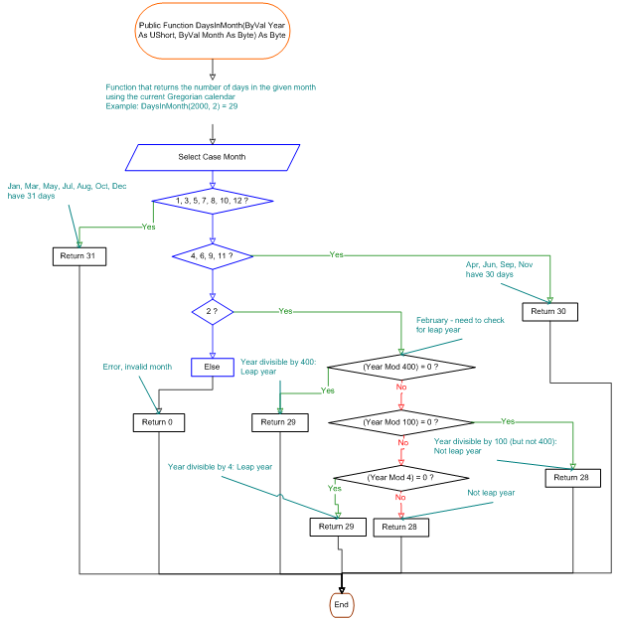

Slide 7
